Slide 1
Capstone Project 1 Taarifa Waterpoint Prediction
Jason Lam

Slide 2

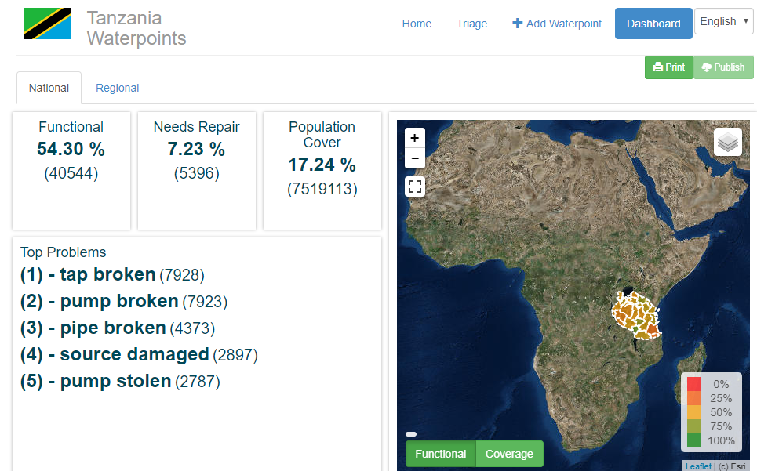
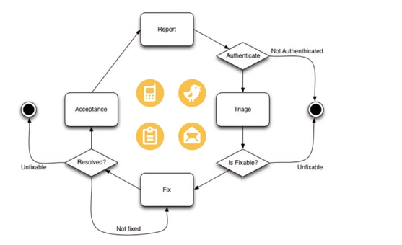
Taarifa is an open source web API designed for crowd sourced reporting and triaging infrastructure problems in developing countries.

Slide 3
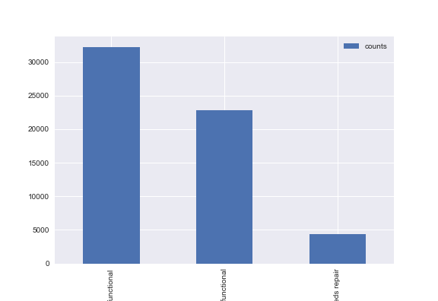
Dataset: 39 Waterpoint Variables
amount_tsh - Total static head (amount water available to waterpoint)
date_recorded - The date the row was entered
funder - Who funded the well
gps_height - Altitude of the well
installer - Organization that installed the well
longitude - GPS coordinate
latitude - GPS coordinate
wpt_name - Name of the waterpoint if there is one
num_private -
basin - Geographic water basin
subvillage - Geographic location
region - Geographic location
region_code - Geographic location (coded)
district_code - Geographic location (coded)
lga - Geographic location
ward - Geographic location
population - Population around the well
public_meeting - True/False
recorded_by - Group entering this row of data
scheme_management - Who operates the waterpoint
scheme_name - Who operates the waterpoint
permit - If the waterpoint is permitted
construction_year - Year the waterpoint was constructed
extraction_type - The kind of extraction the waterpoint uses
extraction_type_group - The kind of extraction the waterpoint uses
extraction_type_class - The kind of extraction the waterpoint uses
management - How the waterpoint is managed
management_group - How the waterpoint is managed
payment - What the water costs
payment_type - What the water costs
water_quality - The quality of the water
quality_group - The quality of the water
quantity - The quantity of water
quantity_group - The quantity of water
source - The source of the water
source_type - The source of the water
source_class - The source of the water
waterpoint_type - The kind of waterpoint
waterpoint_type_group - The kind of waterpoint
3 Waterpoint Operation Status:
functional - the waterpoint is operational and there are no repairs needed
functional needs repair - the waterpoint is operational, but needs repairs
non functional - the waterpoint is not operational

Slide 4
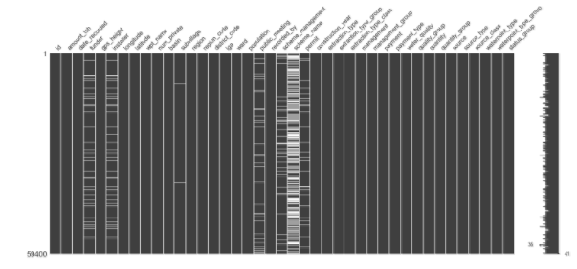
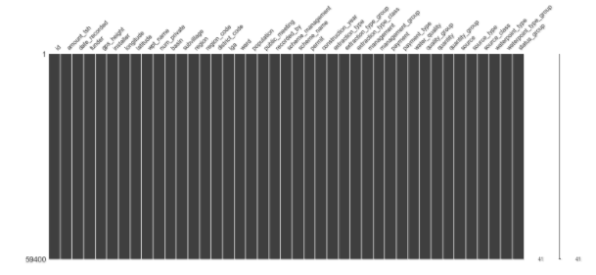
Data Impute: Missing Values in Dataset Were labeled as “Missing”
Features | # of missing values
funder | 3635
installer | 3655
subvillage | 371
public_meeting | 3334
scheme_management | 3877
scheme_name | 28166
permit | 3056
Before Impute
After Impute

Slide 5
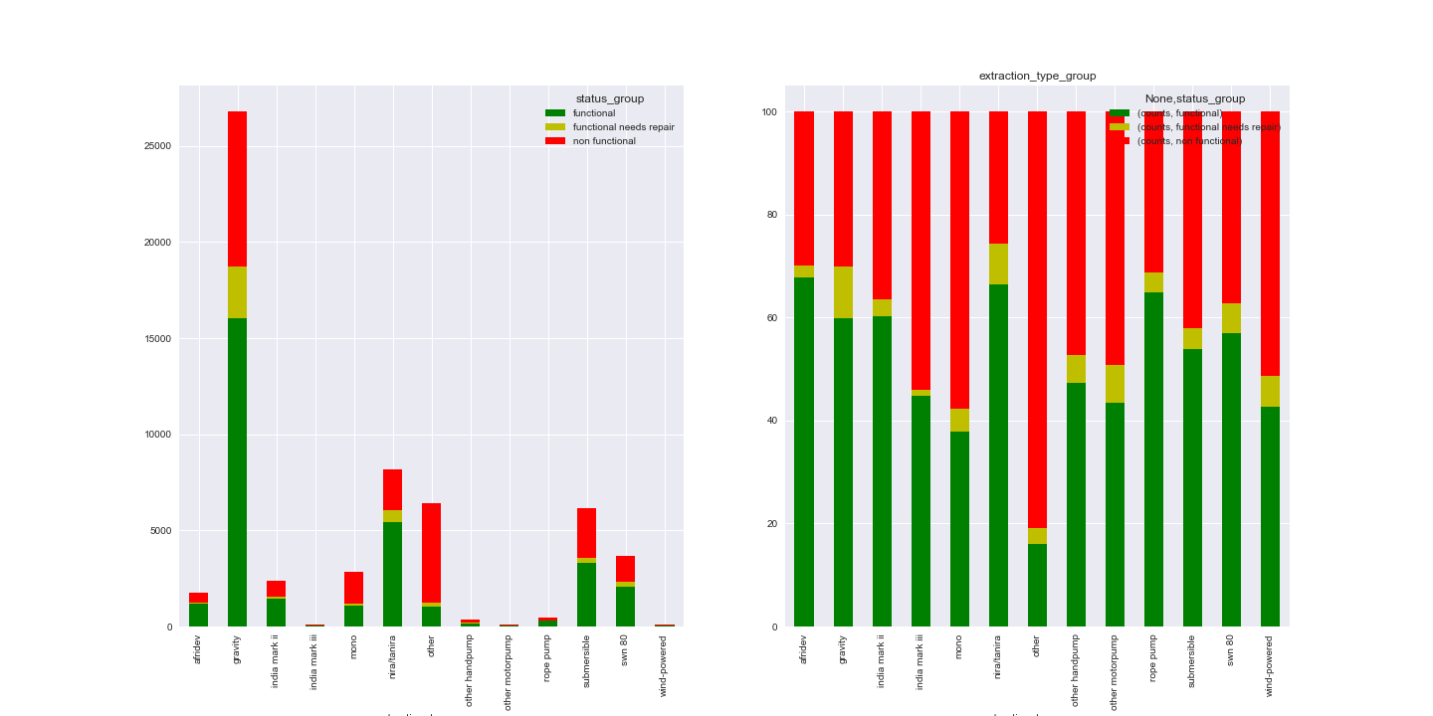
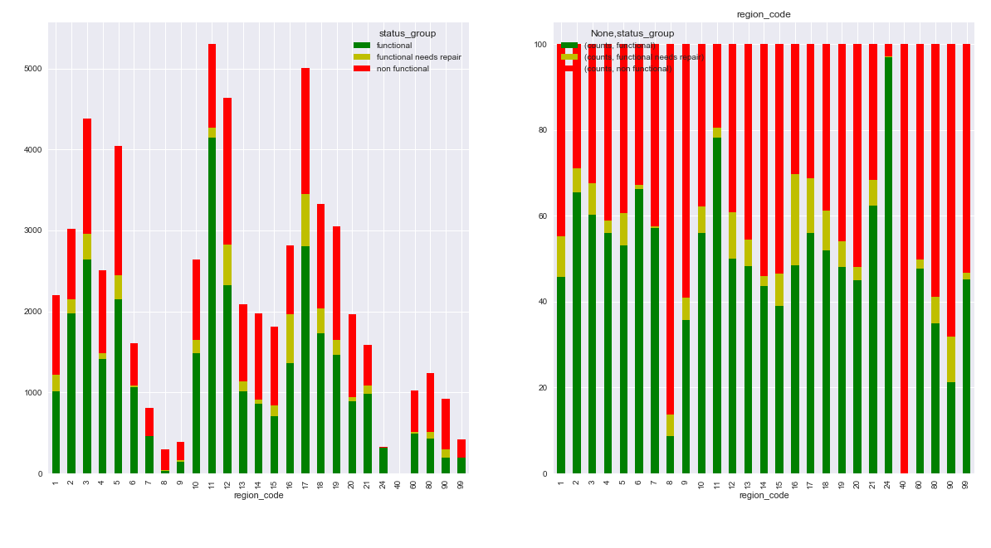
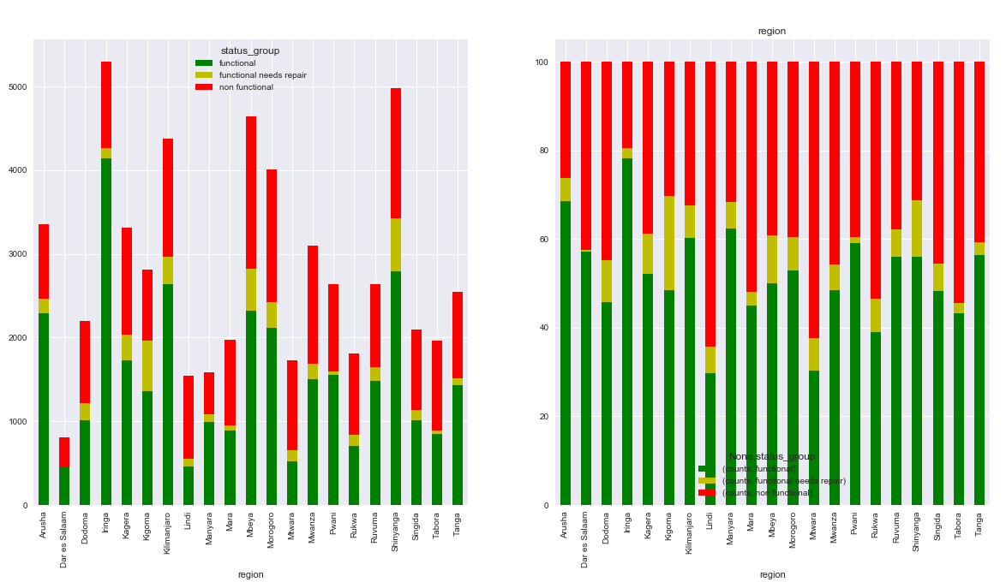
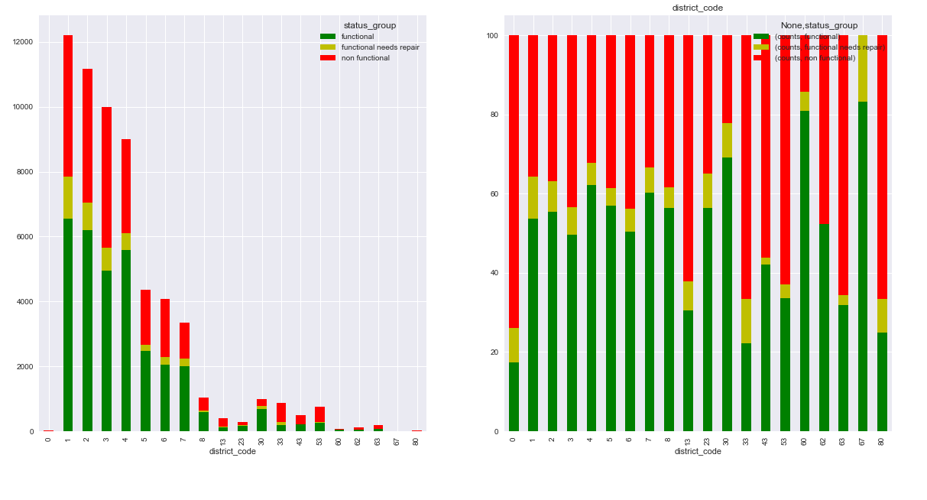
Exploratory Data Analysis 1
Extraction Type
Region Code
Region
District Code

Slide 6
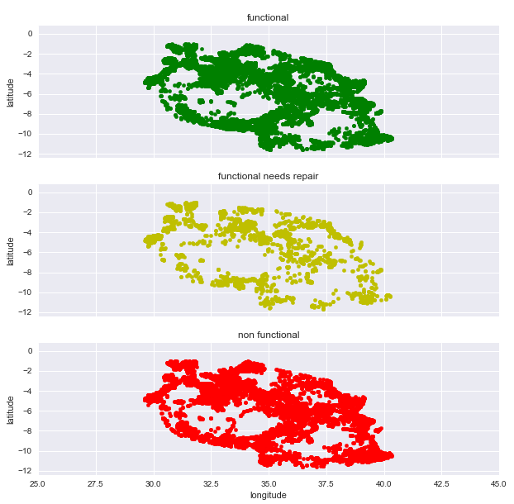
Exploratory Data Analysis 2: No coordinate correlation to operation status.

Slide 7
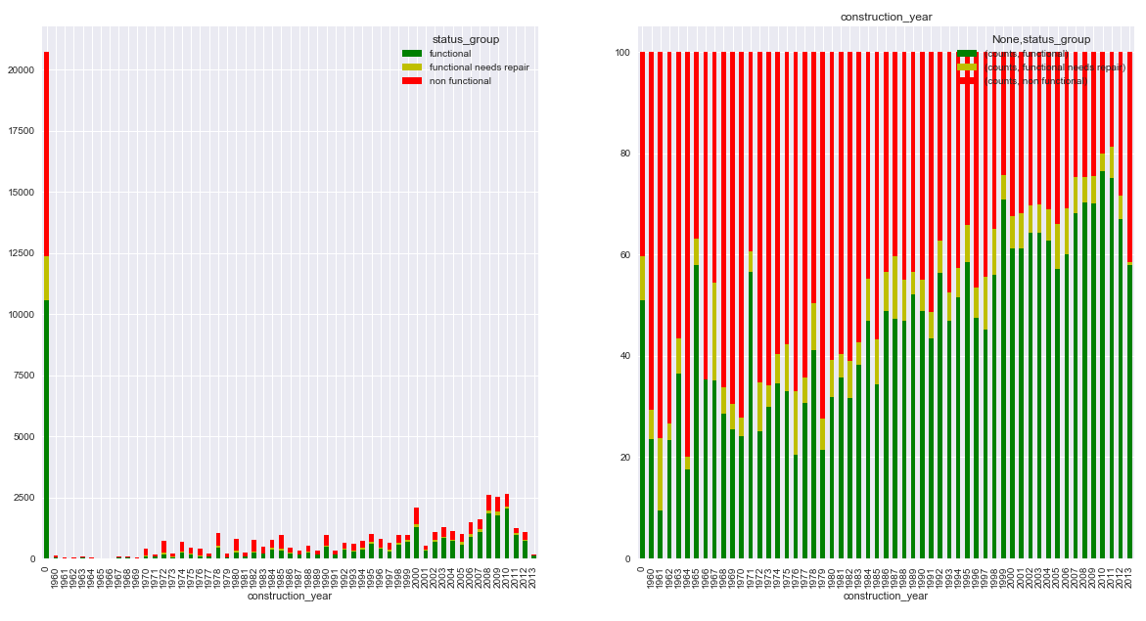
Exploratory Data Analysis 3: Higher proportion of non functional in older waterpoints

Slide 8
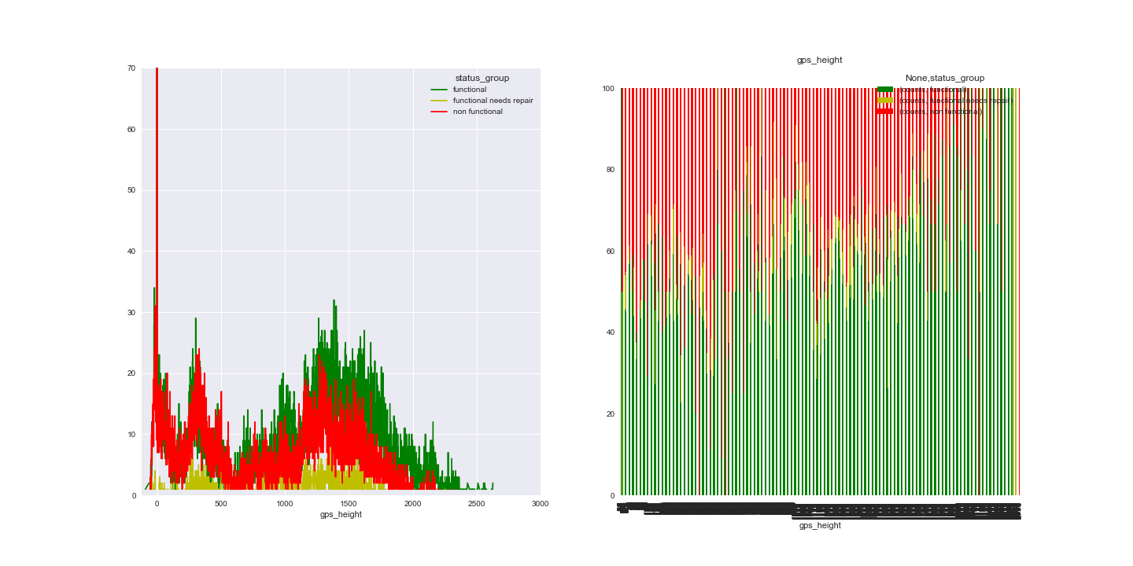
Exploratory Data Analysis 3: Higher proportion of non functional in lower waterpoints

Slide 9
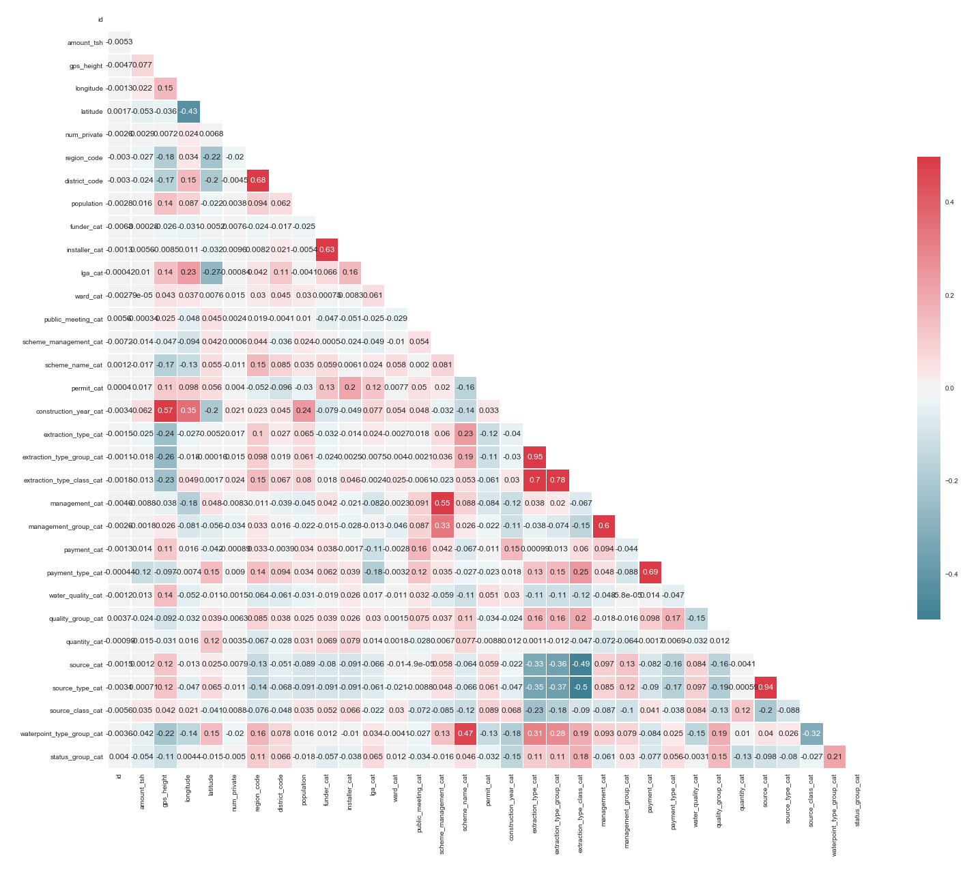
Correlation Matrix after Label Encoding

Slide 10
Random Forest is the best performer in prediction accuracy.
 | HyperParameter |  | Accuracy
Logistic Regression | C
 | 0.001 |  | 0.707
 | 0.1 |  | 0.709
 | 1 |  | 0.718
 | 10 |  | 0.706
 | 100 |  | 0.708
 | 1000 |  | 0.708
 | 10000 |  | 0.706
Random Forest | Leaf | n_estimators
 | 1 | 100 | 0.798
 | 50 | 100 | 0.698
 | 500 | 100 | 0.618
 | 1500 | 100 | 0.558
 | 1 | 500 | 0.799
 | 1 | 2500 | 0.802
 | 1 | 5000 | 0.801
Gaussian Naïve Bayes |  |  | 0.440
Multinomial Naïve Bayes |  |  | 0.450

Slide 11
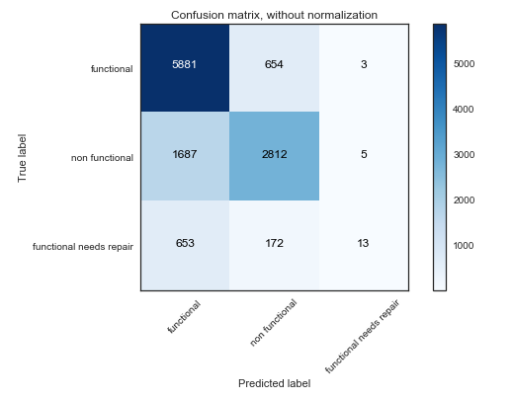
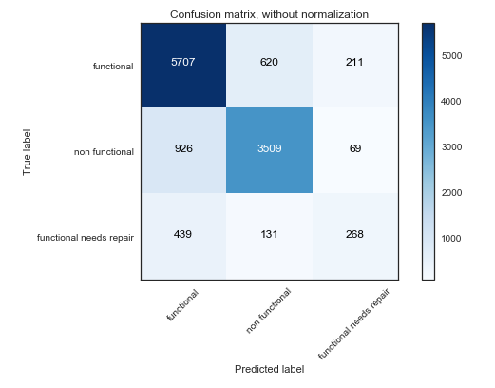
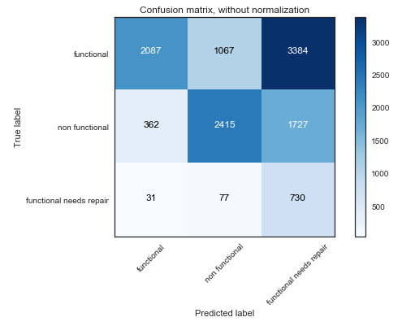
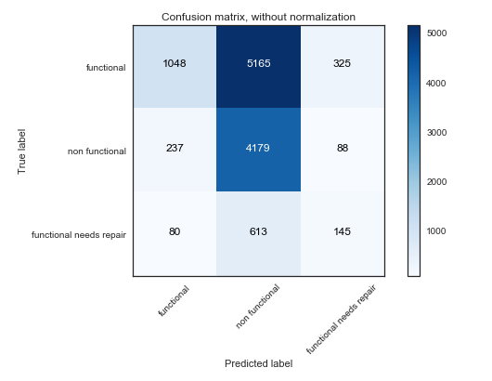
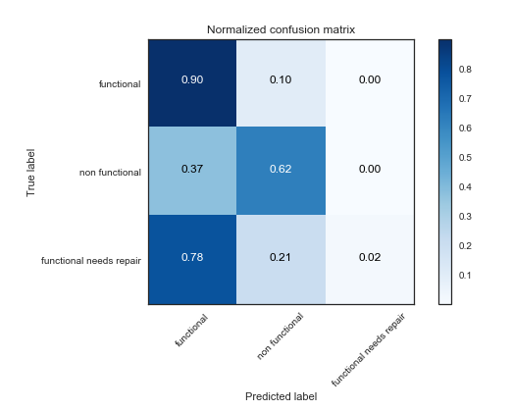
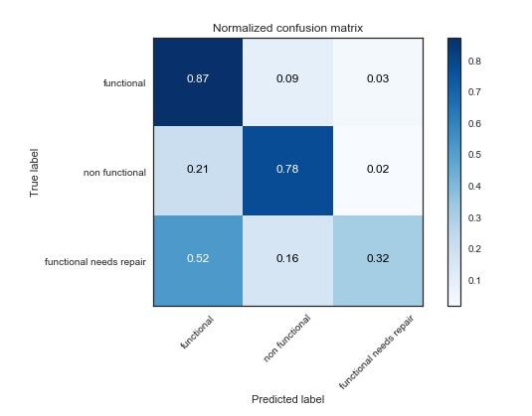
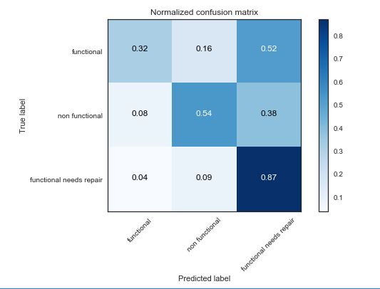
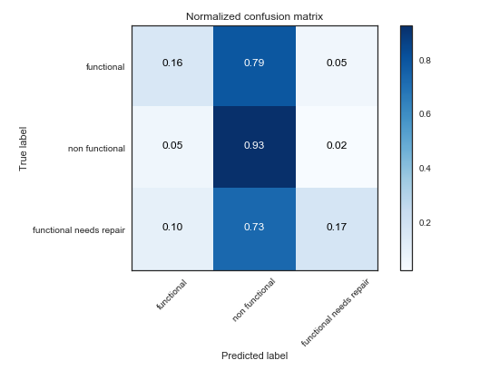
 |  | Accuracy | Precision | Recall | F1
Logistic Regression |  | 0.71 | 0.68 | 0.71 | 0.68
Random Forest |  | 0.80 | 0.79 | 0.80 | 0.79
Gaussian Naïve Bayes |  | 0.44 | 0.73 | 0.44 | 0.50
Multinomial Naïve Bayes |  | 0.45 | 0.60 | 0.45 | 0.38
Random Forest has the best prediction metrics.
Logistic Regression
Random Forest
Gaussian
Multinomial

Slide 12

Random Forest has a hard time predicting “functional needs repair”.

Slide 13
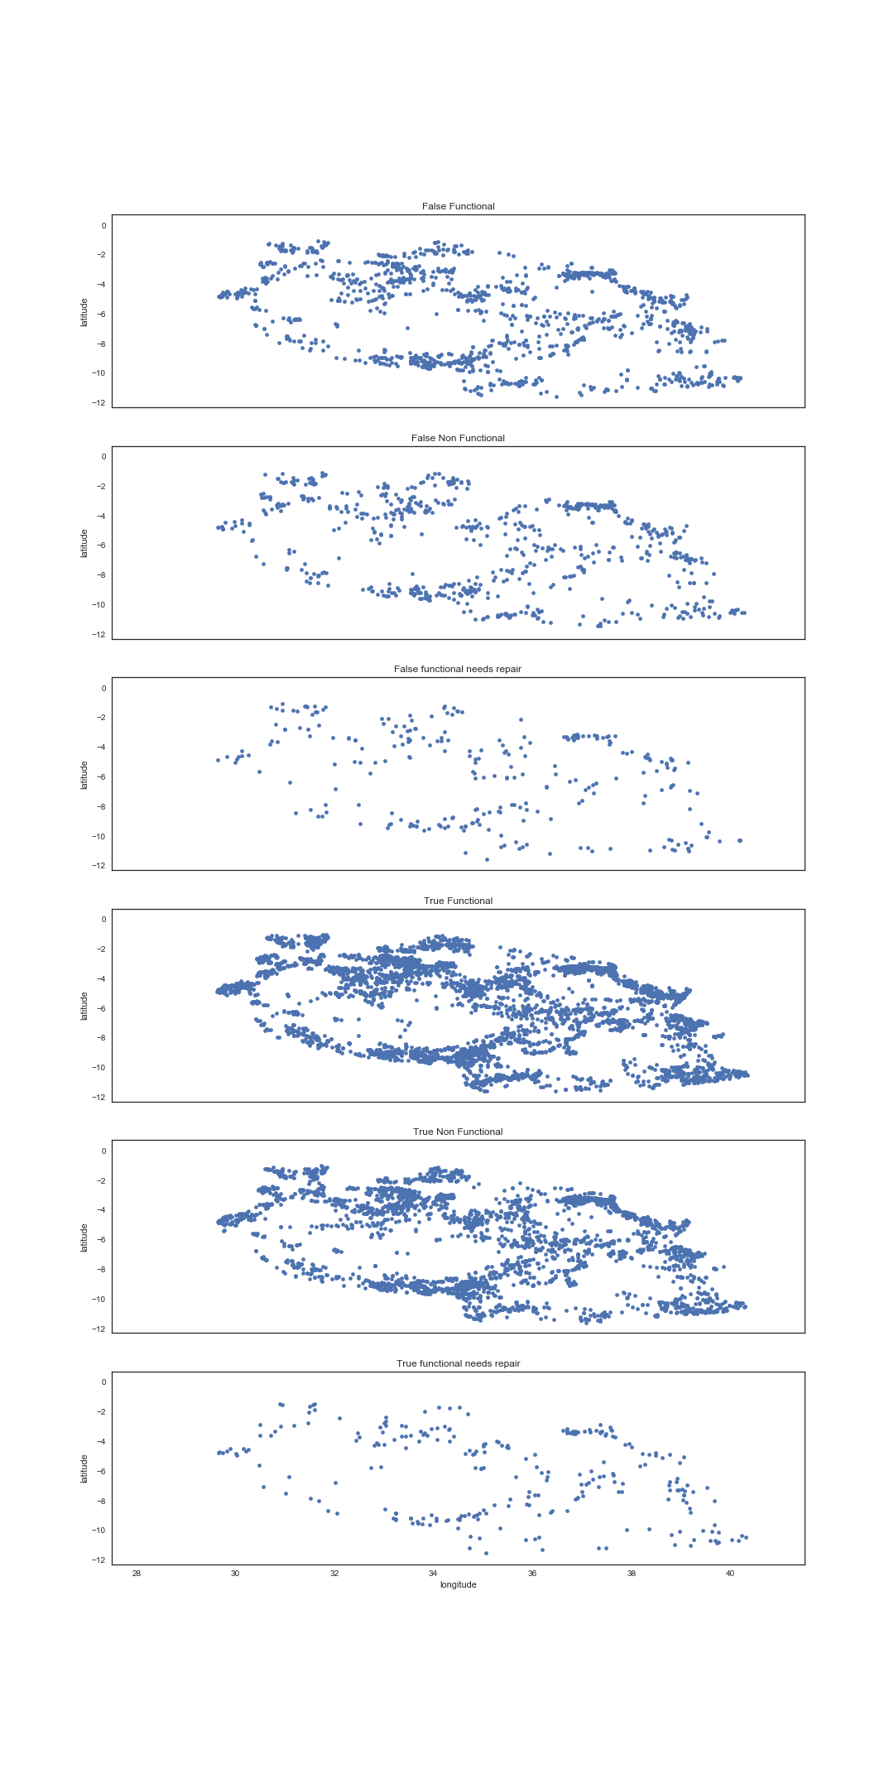
No Coordinate correlation for False Functional Needs Repair
False Functional
False Non Functional
False Functional Needs Repair
True Functional
True Non Functional
True Functional Needs Repair

Slide 14
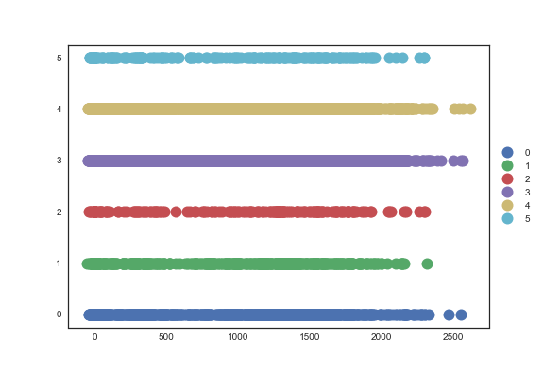
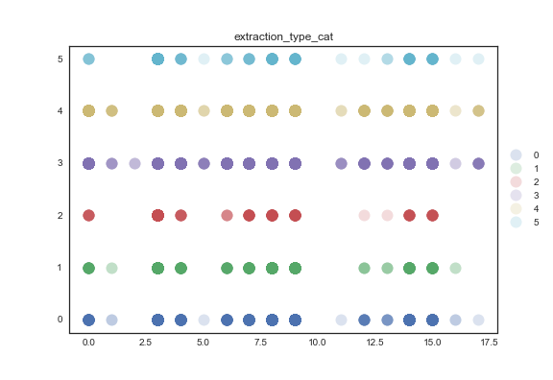
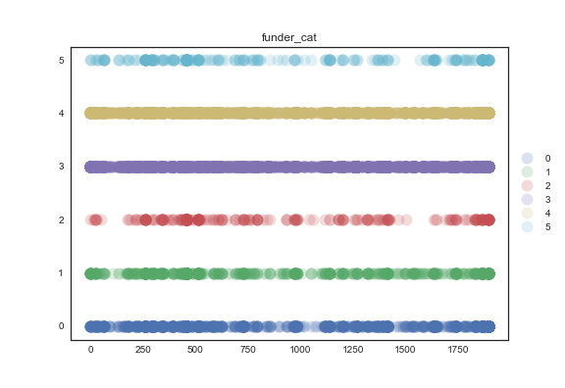
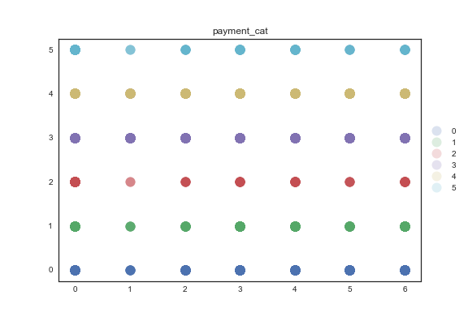
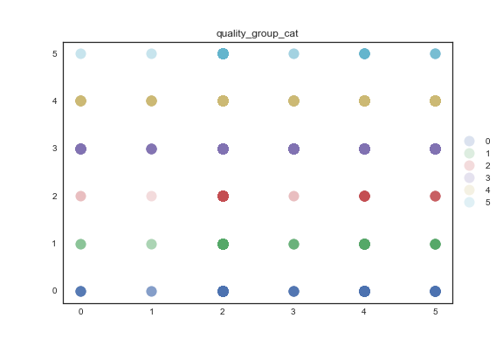
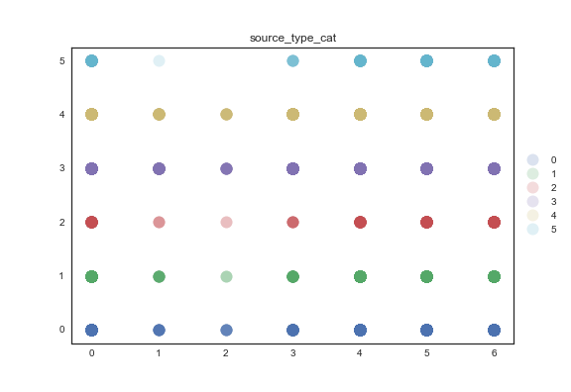
No Obvious Reason for Misclassified Status.
GPS Height
Extraction Type
Funder
True Functional Needs Repair
True Non Functional
True Functional
False Functional Needs Repair
False Non Functional
False Functional
Payment
Quality
Source
True Functional Needs Repair
True Non Functional
True Functional
False Functional Needs Repair
False Non Functional
False Functional

